Slide 1
4. Random variables

Slide 2
Contents
Random Variables
Discrete Random Variables
Expected Value
Expectation of a Function of a Random Variable
Variance
The Bernoulli and Binomial Random Variables
The Poisson Random Variable
Other Discrete Probability Distributions

Slide 3
4.1 Random variable
Understanding random variables
Why introduce RV

Slide 4
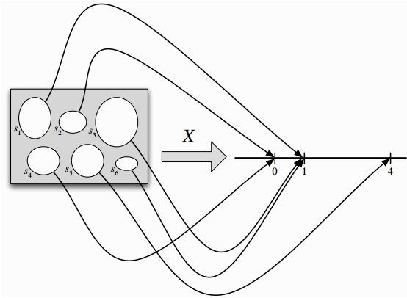
Random variable
Given an experiment with sample space S, a random variable (r.v.) is a function from the sample space S to the real numbers R. It is common, but not required, to denote random variables by capital letters.

Slide 5
Random variable
Event is a set whose element may be numbers or
non-number.
Random variable is a set whose element are numbers.
Mapping relation an experiment outcome and a value of r.v.
The value of r.v. has randomness

Slide 6
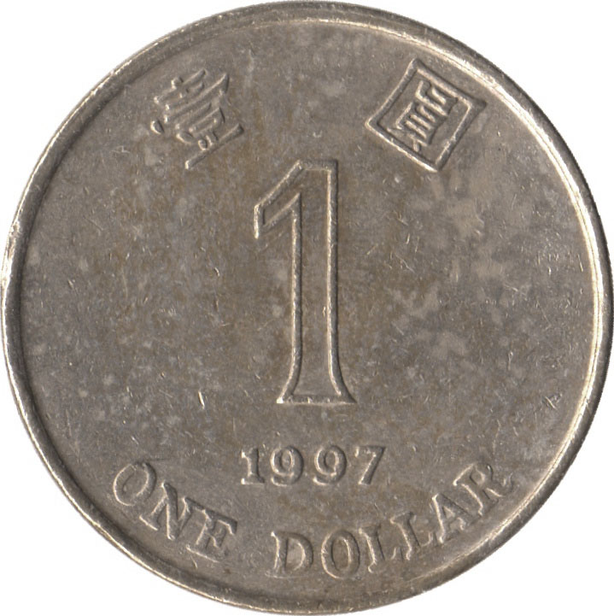
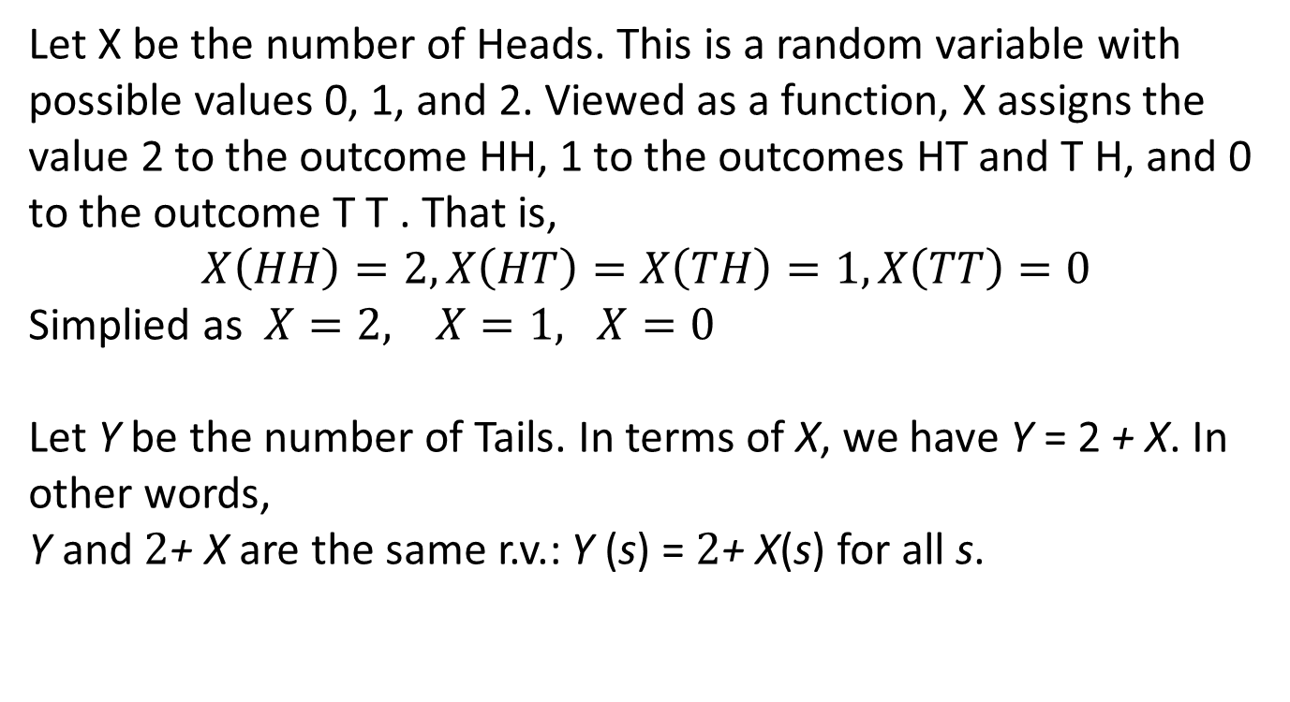
Random variable
Example
{ HH, HT, TH, TT }
Let X be the number of Heads. This is a random variable with possible values 0, 1, and 2. Viewed as a function, X assigns the value 2 to the outcome HH, 1 to the outcomes HT and T H, and 0 to the outcome T T . That is,
$$X\left(HH\right)=2,X\left(HT\right)=X\left(TH\right)=1, X\left(TT\right)=0$$
Simplied as $X=2, X=1, X=0$
Let Y be the number of Tails. In terms of X, we have Y = 2 + X. In other words, Y and $2$+ X are the same r.v.: Y (s) = $2$+ X(s) for all s.
Notes:
Can give an example of dices, P(X<4), etc.

Slide 7
4.2 Discrete Random variable
Definition
PMF
CDF

Slide 8
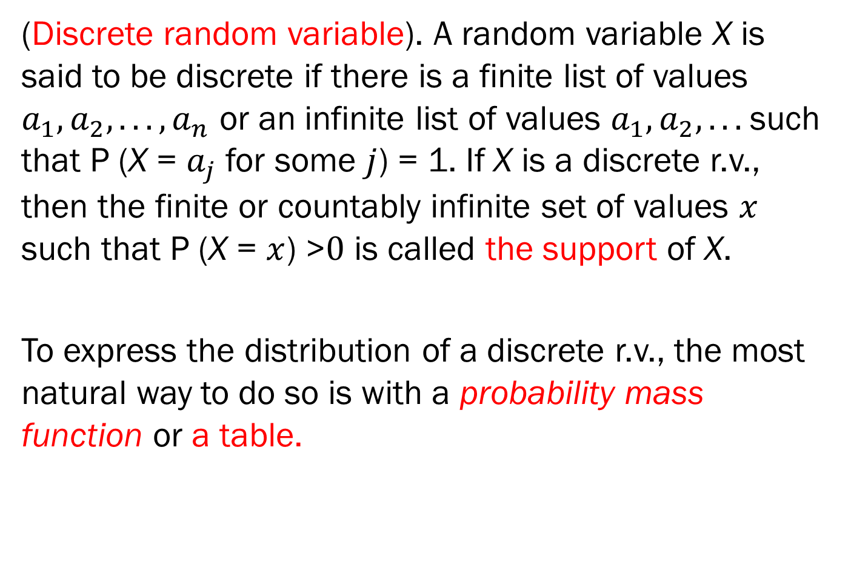
4.2 Discrete Random variable
(Discrete random variable). A random variable X is said to be discrete if there is a finite list of values $a_{1},a_{2}, . . . ,a_{n}$ or an infinite list of values $a_{1},a_{2},. . .$such that P (X = $a_{j}$ for some $j$) = 1. If X is a discrete r.v., then the finite or countably infinite set of values $x$ such that P (X = $x$) >$0$ is called the support of X.
To express the distribution of a discrete r.v., the most natural way to do so is with a probability mass function or a table.

Slide 9
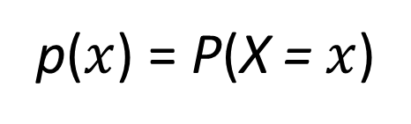
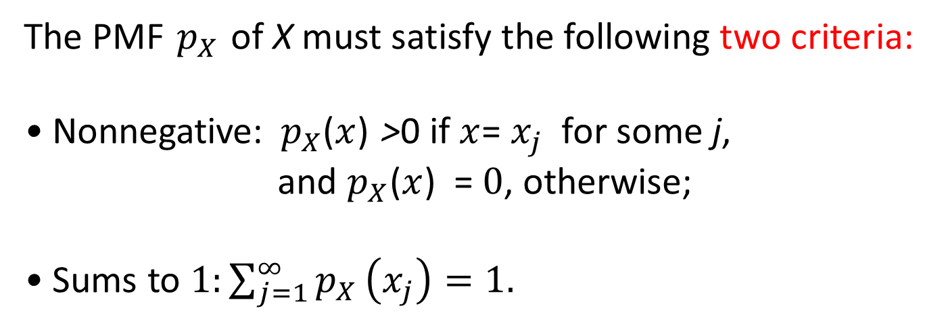
Probability mass function
The probability mass function (p.m.f.) of discrete random variable X is the function
p($x$) = P(X = $x$)
The PMF $p_{X}$ of X must satisfy the following two criteria:
• Nonnegative:${ p}_{X}$($x$) >0 if $x$= $x_{j}$ for some j,
and $p_{X}$($x$) = $0$, otherwise;
• Sums to $1:\sum_{j=1}^{∞}{p_{X}}\left(x_{j}\right)=1.$

Slide 10
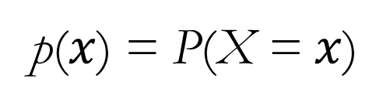
Probability mass function
The probability mass function (p.m.f.) of discrete random variable X is the function
p($x$) = P(X = $x$)
Example
{ HH, HT, TH, TT }
¼
¼
¼
¼
N = number of Hs
p(0) = P(N = 0) = P({TT}) = 1/4
p(1) = P(N = 1) = P({HT, TH}) = 1/2
p(2) = P(N = 2) = P({HH}) = 1/4

Slide 11
Probability mass function
We can describe the p.m.f. by a table or by a chart.
x 0 1 2
p(x)
p(x) ¼ ½ ¼
x

Slide 12

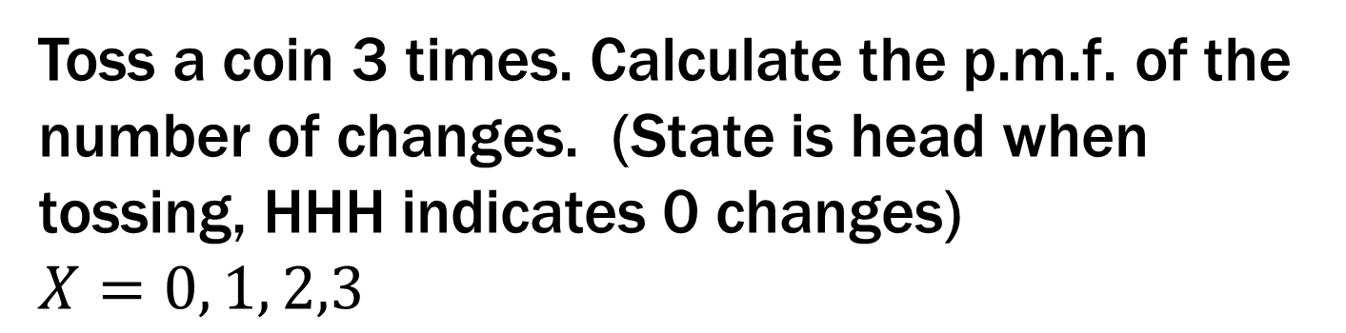
Example 3.1
A change occurs when a coin toss comes out different from the previous one.
Toss a coin 3 times. Calculate the p.m.f. of the number of changes. (State is head when tossing, HHH indicates 0 changes)
$X=0, 1, 2,3$

Slide 13
Example 3.2 Balls
We draw 3 balls without replacement from this urn:
0
1
-1
0
1
0
1
-1
-1
Let X be the sum of the values on the balls. What is the p.m.f. of X?

Slide 14
Example Balls
0
1
-1
X = sum of values on the 3 balls
0
1
0
E_{abc}: we chose balls of type a, b, c
1
-1
-1
P(X = 0)
= P(E₀₀₀) + P(E₁₍₋₁₎₀)
= (1 + 3×3×3)/C(9, 3) = 28/84
P(X = 1)
= P(E₁₀₀) + P(E₁₁₍₋₁₎)
= (3×3 + 3×3)/C(9, 3) = 18/84
P(X = -1)
= P(E₍₋₁₎₀₀) + P(E₍₋₁₎₍₋₁₎₁)
= (3×3 + 3×3)/C(9, 3) = 18/84
P(X = 2)
= P(E₁₁₀)
= 3×3/C(9, 3)
= 9/84
P(X = -2)
= P(E₍₋₁₎₍₋₁₎₀)
= 3×3/C(9, 3)
= 9/84
P(X = 3)
= P(E₁₁₁)
= 1/C(9, 3)
= 1/84
P(X = -3)
= P(E₍₋₁₎₍₋₁₎₍₋₁₎)
= 1/C(9, 3)
= 1/84
1

Slide 15
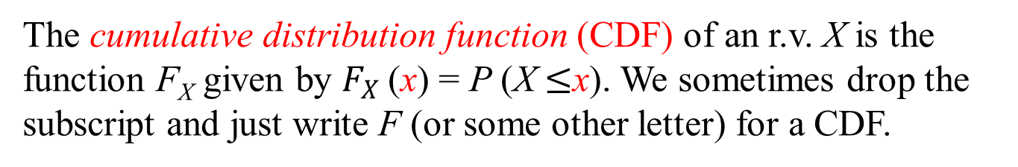
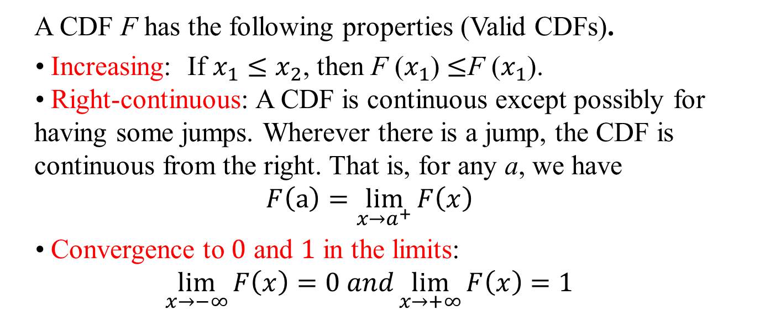
Cumulative distribution function
The cumulative distribution function (CDF) of an r.v. X is the function F_{X} given by $F_{X}$(x) = P (X $≤$x). We sometimes drop the subscript and just write F (or some other letter) for a CDF.
Here{X ≤ x} = the set of all outcomes (event) with X ≤ x.
A CDF F has the following properties (Valid CDFs).
• Increasing: If $x_{1}{≤x}_{2}$, then F ($x_{1}$) $≤$F ($x_{1}$). • Right-continuous: A CDF is continuous except possibly for having some jumps. Wherever there is a jump, the CDF is continuous from the right. That is, for any a, we have $$F\left(a\right)=\lim_{x→a^{+}}{F\left(x\right)}$$
• Convergence to $0$ and $1$ in the limits: $$\lim_{x→−∞}{F\left(x\right)=0 and\lim_{x→+∞}{F\left(x\right)=1}}$$

Slide 16
Example 3.3
Two dice are rolled and X is the sum of the two upward faces. S , sample space is shown below with the value of X for each outcome
(1,1) 2 | (1,2) 3 | (1,3) 4 | (1,4) 5 | (1,5) 6 | (1,6) 7
(2,1) 3 | (2,2) 4 | (2,3) 5 | (2,4) 6 | (2,5) 7 | (2,6) 8
(3,1) 4 | (3,2) 5 | (3,3) 6 | (3,4) 7 | (3,5) 8 | (3,6) 9
(4,1) 5 | (4,2) 6 | (4,3) 7 | (4,4) 8 | (4,5) 9 | (4,6) 10
(5,1) 6 | (5,2) 7 | (5,3) 8 | (5,4) 9 | (5,5) 10 | (5,6) 11
(6,1) 7 | (6,2) 8 | (6,3) 9 | (6,4) 10 | (6,5) 11 | (6,6) 12

Slide 17
Example 3.3

Slide 18
Example 3.3
p(x)
x

Slide 19
Example 3.3
How to obtained CDF:
{X ≤ x} = the set of all outcomes (event) with X ≤ x.
Note {X ≤ x} = φ if x < 2. Thus F(x) = 0.
{X ≤ x} = {(1,1)} if 2 ≤ x < 3. Thus F(x) = 1/36
{X ≤ x} = {(1,1) ,(1,2),(1,2)} if 3 ≤ x < 4. Thus F(x) = 3/36

Slide 20
Example 3.3
Continuing we find:
F(x) is a step function

Slide 21
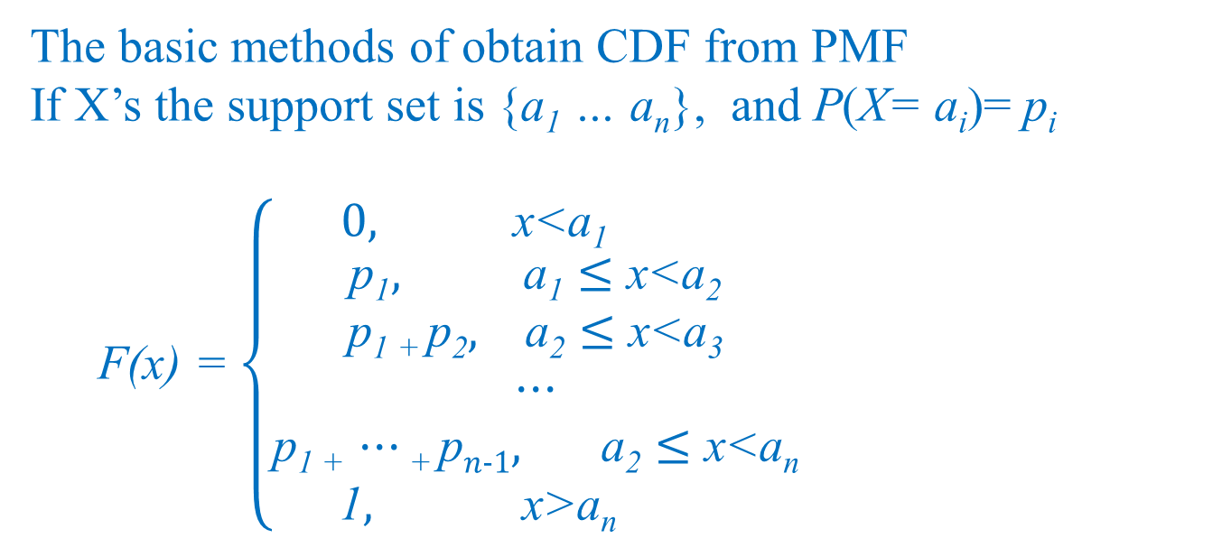
Relations between PMF and CDF
PMF and CDF are equivalent. Namely, if PMF is available, then CDF can be obtained; if CDF is available, then PMF can be obtained.
The basic methods of obtain CDF from PMF
If X’s the support set is {a₁ … a_{n}}, and P(X= a_{i})= p_{i}
F(x) = $\left\{\begin{matrix}0, \text{x}\text{<}\text{a}\text{1} \\ \begin{aligned}\text{p}\text{1}, \text{a}\text{1}≤\text{x}\text{<}\text{a}\text{2} \\ \text{p}\text{1}\text{ + }\text{p}\text{2}, \text{a}\text{2}≤\text{x}\text{<}\text{a}\text{3} \\ ⋯ \\ \text{p}\text{1 +} ⋯\text{+} \text{p}n−1, \text{a}\text{2}≤\text{x}\text{<}\text{an}\end{aligned} \\ \text{1}, \text{x}\text{>}\text{a}\text{n} \end{matrix}\right.$

Slide 22
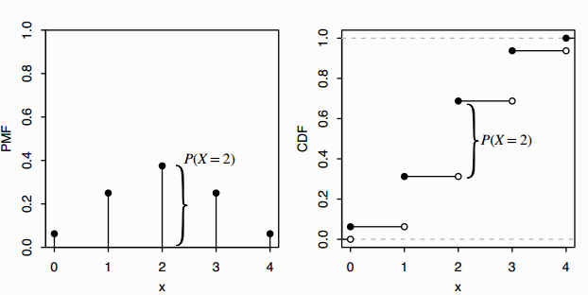
Relations between PMF and CDF
PMF and CDF are equivalent. Namely, if PMF is available, then CDF can be obtained; if CDF is available, then PMF can be obtained.
The basic methods of obtain PMF from CDF
To find the jump points, which is the support of X

Slide 23
Exercise
There are 50 students in our class.
Every Tuesday I call 5 students to do problems on the board. There are 11 such Tuesdays.
What are the chances you are never called?

Slide 24
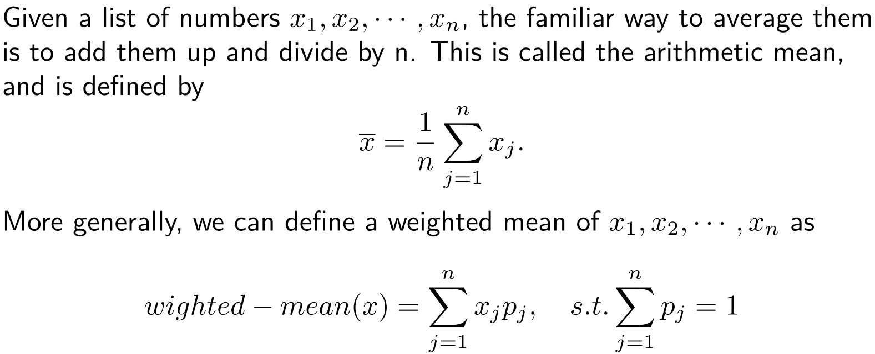
3.3 Expected value
Arithmetic mean :

Slide 25
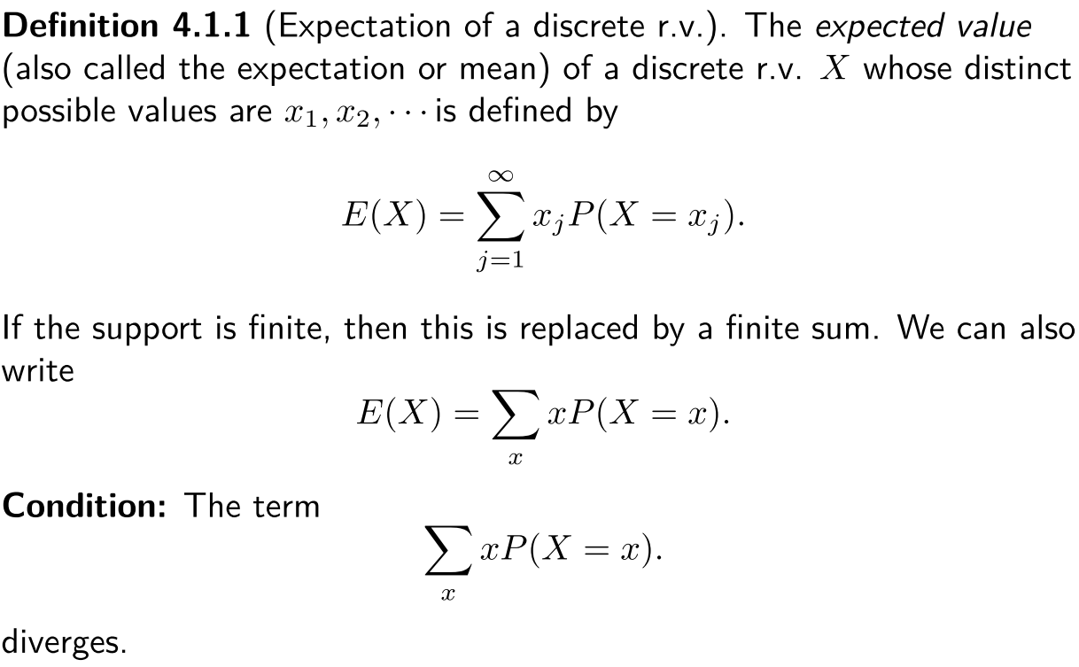
3.3 Expected value
Definition:

Slide 26
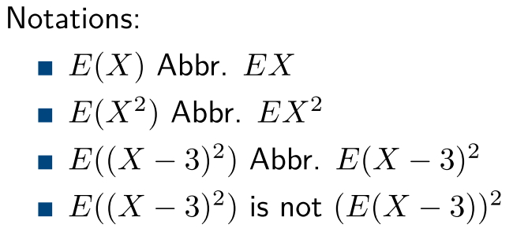
3.3 Expected value

Slide 27
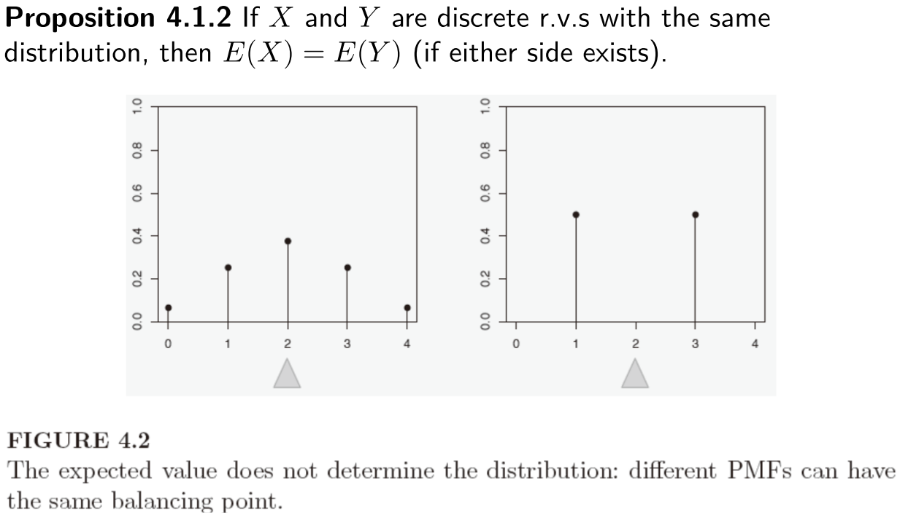
3.3 Expected value

Slide 28
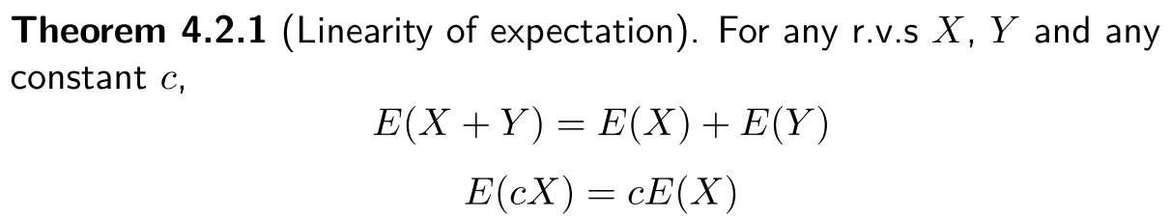
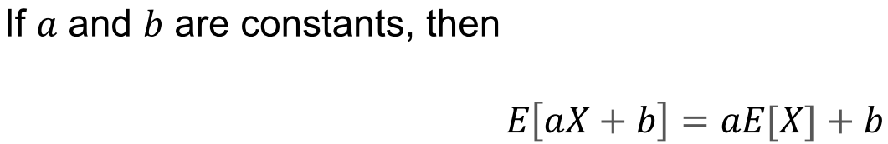
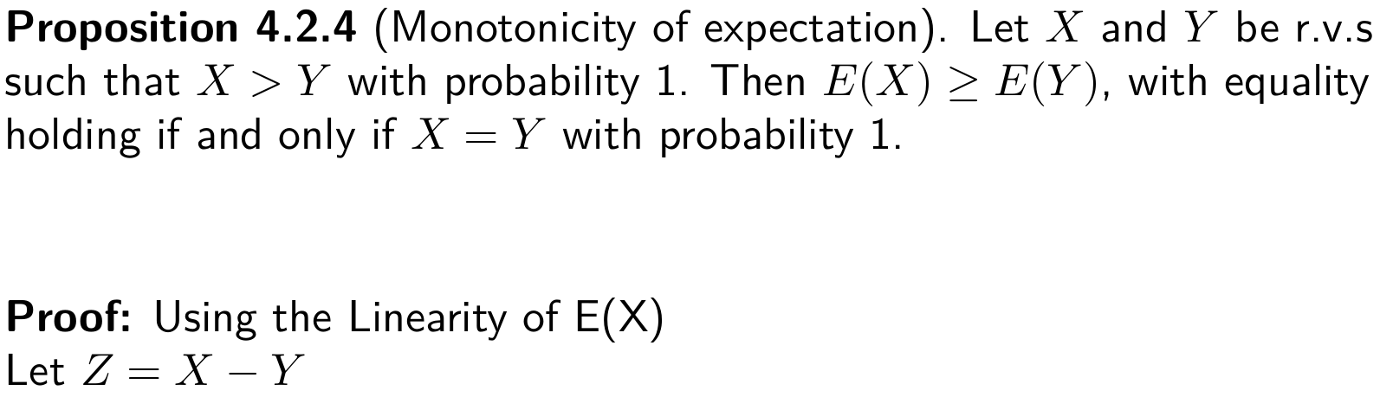
3.3 Expected value

Slide 29
3.3 Expected value
The expected value (expectation) of a random variable X with p.m.f. p is
E[X] = ∑_{x} x p(x)
Example
N = number of Hs
x 0 1
p(x) ½ ½
E[N] = 0 ½ + 1 ½ = ½

Slide 30
3.3 Expected value
Example
E[N]
N = number of Hs
x 0 1 2
p(x) ¼ ½ ¼
E[N] = 0 ¼ + 1 ½ + 2 ¼ = 1
The expectation is the average value the random variable takes when experiment is done many times

Slide 31

3.3 Expected value
Example
F = face value of fair 6-sided die
1
1
1
1
1
1
E[F] = 1 + 2 + 3 + 4 + 5 + 6 = 3.5
6
6
6
6
6
6

Slide 32


Exercise Russian roulette
Alice
Bob
S = { H, MH, MMH, MMMH, MMMH, …}
E.g. MMH: Alice misses, then Bob misses, then Alice kills
A = “Alice wins” = { H, MMH, MMMMH, …}
N = number of rounds
what is E[N]?

Slide 33
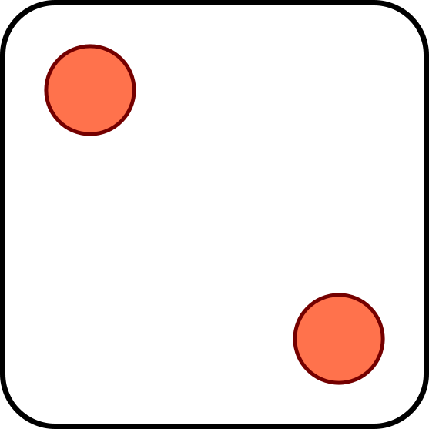
Example 3.4 Chuck-a-luck
1
2
3
4
5
6
If appears k times, you win $k.
If it doesn’t appear, you lose $1.

Slide 34
Example 3.4 Chuck-a-luck
Solution
X the times of appearing 2
P = profit
X
0 1 2 3
P
-1 1 2 3
5
1
1
5
5
1
( )
( )²
( )³
p(n)
( )³
3
( )²
( )
3
6
6
6
6
6
6
E[P] = -1 (5/6)³ + 1 3(5/6)²(1/6)² + 2 3(5/6)(1/6)² + 3 (5/6)³ = -17/216

Slide 35
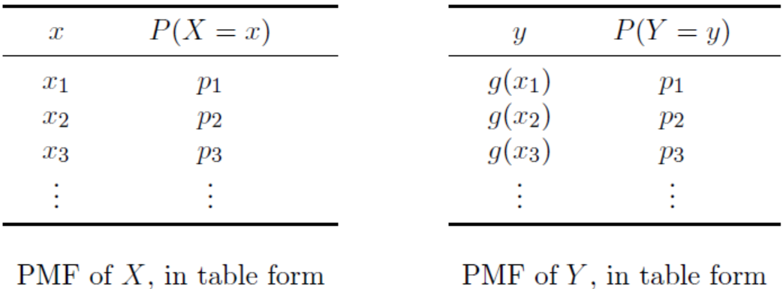
3.4 Expectation of Functions of random variables
In general, if X is a random variable and g a function, then Y = g(X) is a random variable with p.m.f.
p_{Y}(y) = ∑_{x: g(x) = y} p_{X}(x).
P (Y = g(x)) = P (g(X) = g(x)) = P (X = x).

Slide 36
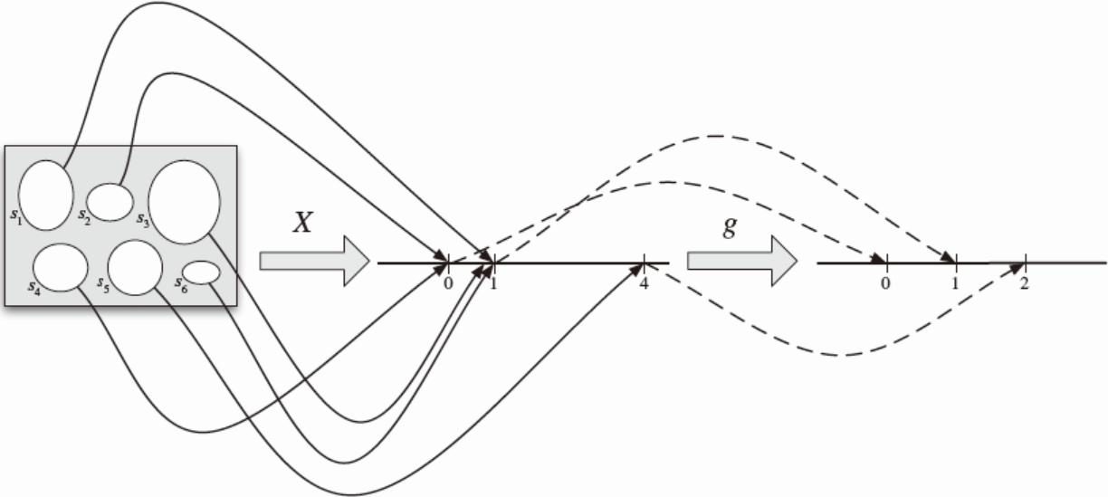

3.4 Expectation of Functions of random variables
X 0， 1 ， 4. Y=$\sqrt{X}$
.

Slide 37
Review of Expectation
A discrete random variable X assigns a discrete value to every outcome in the sample space.
E[N]
Probability mass function of X: p(x) = P(X = x)
Expected value of X: E[X] = ∑_{x} x p(x).
N: number of heads in two coin flips

Slide 38
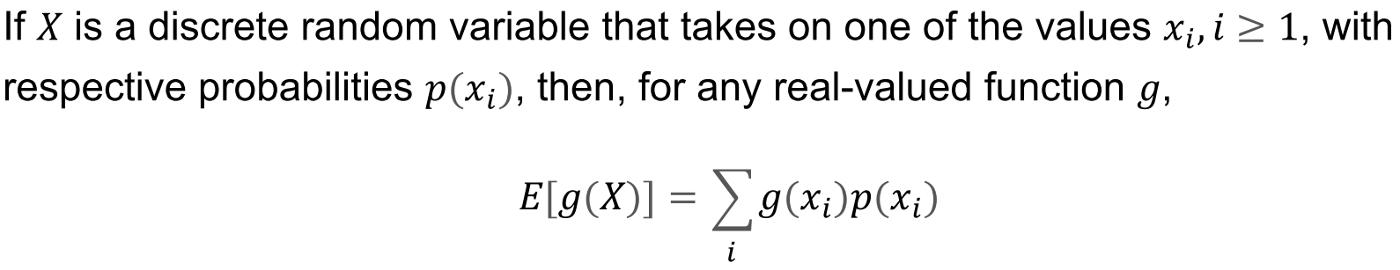
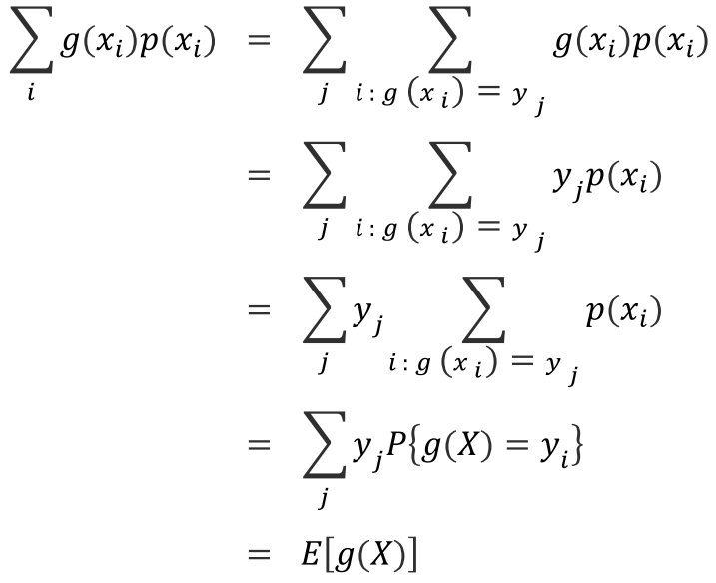
Review of Expectation
Expectation of function of a r.v. X, Y =g(X)
To compute E(Y)

Slide 39

Example 3.5

Slide 40
Two dice
S = sum of face values of two fair 6-sided dice
Solution 1
We calculate the p.m.f. of S:
s
2 3 4 5 6 7 8 9 10 11 12
p_{S}(s)
1
2
3
4
5
6
5
4
3
2
1
36
36
36
36
36
36
36
36
36
36
36
1
2
1
= 7
E[S] = 2 + 3 + … + 12
36
36
36

Slide 41
Two dice again
S = sum of face values of two fair 6-sided dice
F₁
F₂
S = F₁ + F₂
F₁ = outcome of first die
F₂ = outcome of second die

Slide 42
Sum of random variables
F₁
F₂
S = F₁ + F₂
11
1
1
2
12
1
2
3
…
…
21
2
1
3
…
…
66
6
6
12

Slide 43
Linearity of expectation
For every two random variables X and Y
E[X + Y] = E[X] + E[Y]

Slide 44
Two dice again
S = sum of face values of two fair 6-sided dice
F₁
F₂
Solution 2
S = F₁ + F₂
E[S] = E[F₁] + E[F₂]
= 3.5 + 3.5 = 7

Slide 45
Example 3.6 Balls
We draw 3 balls without replacement from this urn:
0
1
-1
0
1
-1
1
-1
-1
What is the expected sum of values on the 3 balls?

Slide 46
Example 3.6 Balls
0
1
-1
0
S = B₁ + B₂ + B₃
1
-1
1
where B_{i} is the value of i-th ball.
-1
-1
E[S] = E[B₁] + E[B₂] + E[B₃]
x
-1 0 1
p.m.f of B₁:
p(x)
4
2
3
9
9
9
E[B₁] = -1 (4/9) + 0 (2/9) + 1 (3/9) = -1/9
same for B₂, B₃
E[S] = 3 (-1/9) = -1/3.

Slide 47
Example 3.7 Three dice (Indicator application)
N = number of s. Find E[N].
I₁
I₂
I₃
Solution
1 if face value of kth die equals
I_{k} =
0 if not
N = I₁ + I₂ + I₃
E[N] = E[I₁] + E[I₂] + E[I₃]
= 3 (1/6)
= 1/2
E[I₁] = 1 (1/6) + 0(5/6) = 1/6
E[I₂], E[I₃] = 1/6

Slide 48
Exercise
Five balls are chosen without replacement from an urn with 8 blue balls and 10 red balls.
(a)
What is the expected number of blue balls that are chosen?
(b)
What if the balls are chosen with replacement?

Slide 49
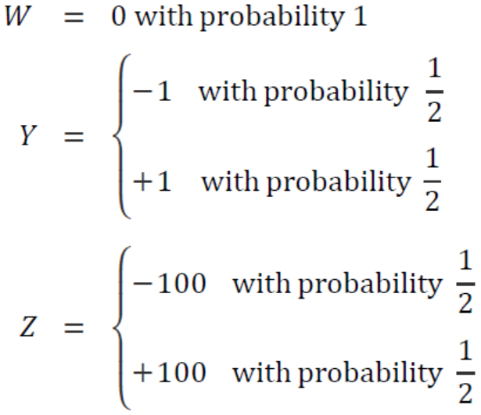
4.5 Variance and standard deviation
Why introducing the Variance?
Expectation only respects the mean of r.v. values, even if the expectation is same, their distributions are different.

Slide 50
4.5 Variance and standard deviation
Let μ = E[X] be the expected value of X.
The variance of X is the quantity
Var[X] = E[(X – μ)²]
= E[X²] – E[X]²
The standard deviation of X is σ = √Var[X]
They measure how close X and μ are typically.
degree of scatter

Slide 51
Calculating variance
μ = E[X]
x
0 50
p(X=x)
½ ½
μ – σ
μ + σ
p.m.f of N_{A}
Var[X] = E[(X – μ)²]
y
25²
= 25²
q(y)
1
σ = std. dev. of X = 25
p.m.f of Y=(X – μ)²

Slide 52
Another formula for variance
for constant c, E[cX] = cE[X]
Var[X] = E[(X – μ)²]
for constant c, E[c] = c
= E[X² – 2μX + μ²]
= E[X²] + E[–2μX] + E[μ²]
= E[X²] – 2μ E[X] + μ²
= E[X²] – 2μ μ + μ²
= E[X²] – μ²
Var[X] = E[X²] – E[X]²

Slide 53
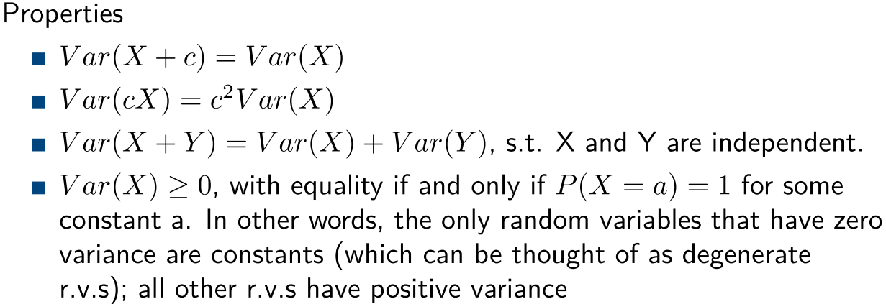
Another properties for variance

Slide 54
4.6 Bernoulli and Binomial Random Variables
Bernoulli trail
Suppose that a trial, or an experiment, whose outcome can be classified as either a success or a failure, is performed.
It is can be used to model the events having two results
n times of Bernoulli trails
Perform n times of Bernoulli trails;
outcomes of each time is independent on the others
It focuses on the times of successes or failures

Slide 55
The indicator (Bernoulli) random variable
Perform a trial that succeeds with probability p and fails with probability 1 – p.
x
0 1
p(x)
p(x)
1 – p p
p = 0.5
If X is Bernoulli(p) then
E[X] = p
p(x)
p = 0.4

Slide 56
The binomial random variable
Binomial(n, p): Perform n independent trials, each of which succeeds with probability p.
X~Binomial(n, p),
X = number of successes
Examples
Toss n coins. (# heads) is Binomial(n, ½).
Toss n dice. (# s) is Binomial(n, 1/6).

Slide 57
Example 3.8 A less obvious example
Toss n coins. Let C be the number of consecutive changes (HT or TH).
Examples:
ω
C(ω)
HHHHHHH
0
THHHHHT
2
HTHHHHT
3
Then C is Binomial(n – 1, ½).

Slide 58
Example 3.9 A non-example
Draw 10 cards from a 52-card deck without replacement.
Let N = number of aces among the drawn cards
Is N a Binomial(10, 1/13) random variable?
No!
Different trial outcomes are not independent.

Slide 59
Properties of binomial random variables
If X is Binomial(n, p), its p.m.f. is
p(k) = P(X = k) = C(n, k) p^{k} (1 - p)^{n-k}
We can write X = I₁ + … + I_{n}, where I_{i} is an indicator random variable for the success of the i-th trial
E[X] = E[I₁] + … + E[I_{n}]
= p + … + p = np.
E[X] = np

Slide 60
Probability mass function
Binomial(10, 0.5)
Binomial(50, 0.5)
Binomial(10, 0.3)
Binomial(50, 0.3)

Slide 61
Example 3.10 Investments
You have two investment choices:
A: put $25 in one stock
B: put $½ in each of 50 unrelated stocks
Which do you prefer?

Slide 62
Investments
Probability model
doubles in value with probability ½
Each stock
loses all value with probability ½
Different stocks perform independently

Slide 63
Investments
A: put $50 in one stock
B: put $½ in each of 50 stocks
N_{A} = amount on choice A
N_{B} = amount on choice B
50 × Bernoulli(½)
Binomial(50, ½)
E[N_{A}]
E[N_{B}]

Slide 64
Variance of binomial random variable
Suppose X is Binomial(n, p).
Then X = I₁ + … + I_{n}, where I_{i} =
1, if trial i succeeds
0, if trial i fails
μ = E[X] = np
Var[X] = E[X²] – μ² = E[X²] – (np)²

Slide 65
Variance of binomial random variable
Suppose X is Binomial(n, p).
μ = E[X] = np
Var[X] = np + n(n-1) p² – (np)²
= np – np² = np(1-p)
Var[X] = np(1-p)
The standard deviation of X is
σ = √np(1-p).

Slide 66
Investments
A: put $50 in one stock
B: put $½ in each of 50 stocks
N_{A} = amount on choice A
N_{B} = amount on choice B
50 × Bernoulli(½)
Binomial(50, ½)
μ
μ
μ – σ
μ + σ
σ = 25
σ = √50 ½ ½ = 3.536…

Slide 67




Example 3.11 Apples
About 10% of the apples on your farm are rotten.
You sell 10 apples. How many are rotten?
Probability model
Number of rotten apples you sold is Binomial(n = 10, p = 1/10).
E[N] = np = 1

Slide 68

Apples
You improve productivity; now only 5% apples rot.
You can now sell 20 apples and only one will be rotten on average.
N is now Binomial(20, 1/20).

Slide 69
.387
Binomial(10, 1/10)
.349
.194
.001
10⁻¹⁰
.377
.354
Binomial(20, 1/20)
.189
.002
10⁻⁸
10⁻²⁶
.367
.367
.183
.003
10⁻⁷
10⁻¹⁹

Slide 70
4.7 The Poisson random variable
A Poisson(λ) random variable has this p.m.f.:
p(k) = e^{-λ} λ ^{k}/k!
k = 0, 1, 2, 3, …
They approximate Binomial(n, p) random variables when λ = np is fixed and n is large (so p is small)
p_{Poisson(λ} ₎(k) = lim_{n → ∞} p_{Binomial(n, λ/n)}(k)

Slide 71
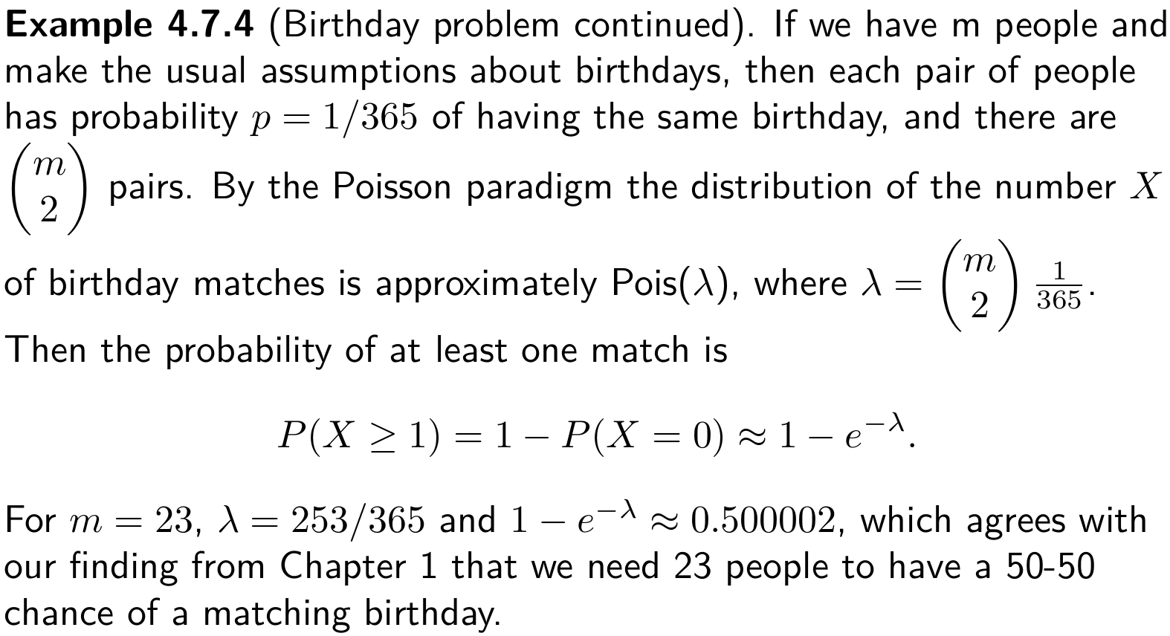
Example Birthday problem

Slide 72
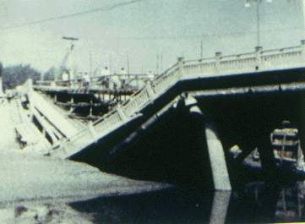
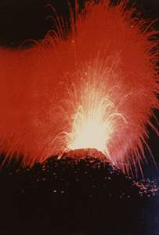

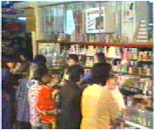

Application of Poisson distribution

Slide 73


Example 3.12 Raindrops
Rain is falling on your head at an average speed of 2.8 drops/second.
0
1
Divide the second evenly in n intervals of length 1/n.
Let E_{i} be the event “raindrop hits during interval i.”
Assuming E₁, …, E_{n} are independent, the number of drops in the second N is a Binomial(n, p) r.v.
Since E[N] = 2.8, and E[N] = np, p must equal 2.8/n.

Slide 74
Raindrops
0
1
Number of drops N is Binomial(n, 2.8/n)
As n gets larger, the number of drops within the second “approaches” a Poisson(2.8) random variable:

Slide 75
Expectation and variance of Poisson
If X is Binomial(n, p) then
E[X] = np
Var[X] = np(1-p)
When p = μ/n, we get
E[X] = μ
Var[X] = μ(1-μ/n)
As n → ∞, E[X] → μ and Var[X] → μ. This suggests
When X is Poisson(μ), E[X] = μ and Var[X] = μ.

Slide 76

Problem for you to solve
Rain falls on you at an average rate of 3 drops/sec.
When 100 drops hit you, your hair gets wet.
You walk for 30 sec from MTR to bus stop.
What is the probability your hair got wet?

Slide 77
Problem for you to solve
Solution
On average, 90 drops fall in 30 seconds.
So we model the number of drops N you receive as a Poisson(90) random variable.
Using the online Poisson calculator at or the poissonpmf(n, L) function, we get
P(N > 100) = 1 - ∑_{i = 0} P(N = i) ≈ 13.49%
⁹⁹

Slide 78
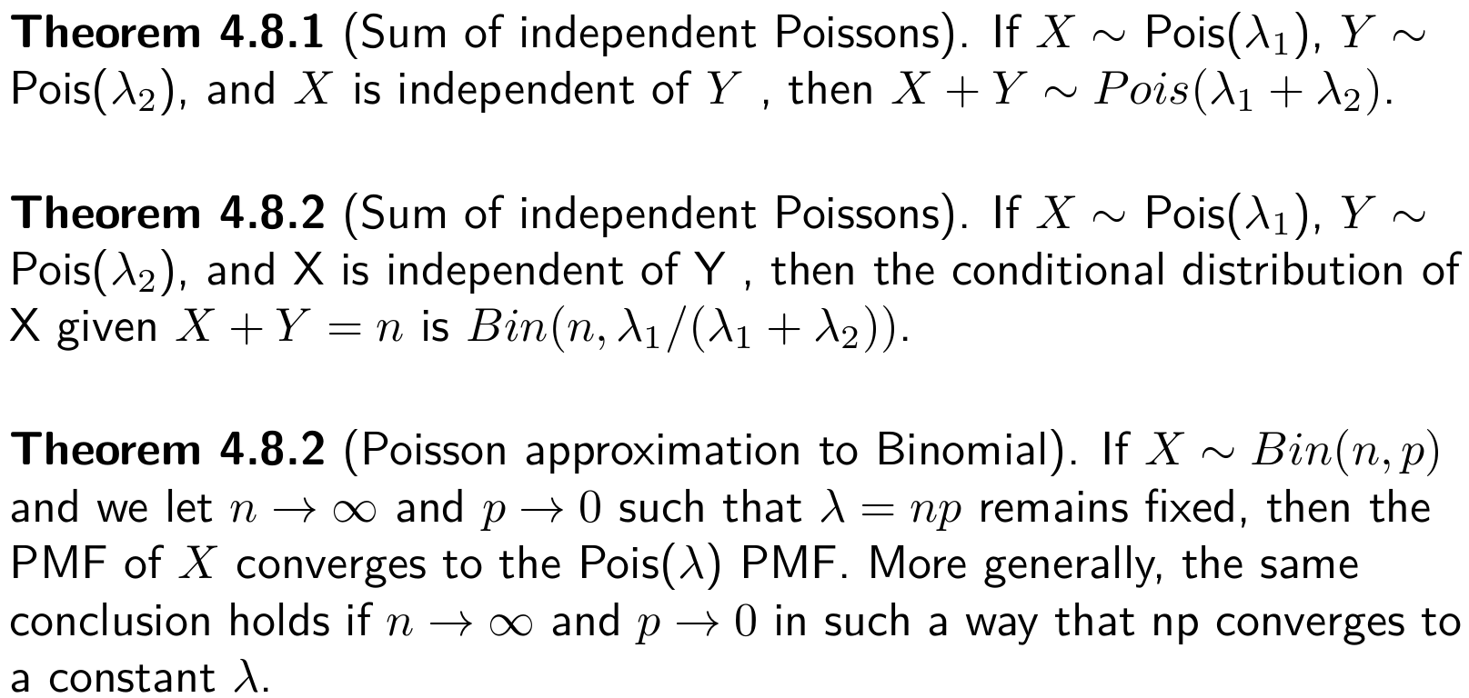
Relation between Bin and Poisson

Slide 79
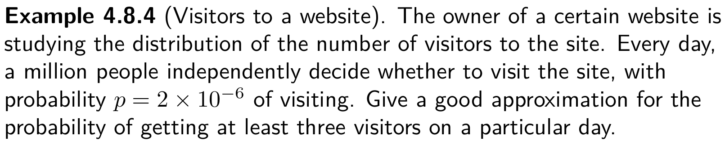
Exercise Website hitting

Slide 80
4.8 Other Discrete Probability Distributions
1 The Geometric Random Variable
2 The Negative Binomial Random Variable
3 The Hypergeometric Random Variable

Slide 81
Geometric Random Variable
Suppose a Bernoulli trial (S,F) is repeated until a success occurs. Let X = the times of the trials when the first success (S) occurs. Find the probability distribution of X.
Note: the possible values of X are {1, 2, 3, 4, 5, … }
The sample space for the experiment is:
S = {S, FS, FFS, FFFS, FFFFS, … , FFF…FFFS, …}
(x – 1) F’s
p(x) =P[X = x] = P[{FFF…FFFS}] = (1 – p)^{x – 1}p

Slide 82
Geometric Random Variable
Thus the probability function of X is:
P[X = x] = p(x) = p(1 – p)^{x – 1} = pq^{x – 1}
A random variable X that has this distribution is said to have the Geometric distribution.
Reason p(1) = p, p(2) = pq, p(3) = pq² , p(4) = pq³ , …
forms a geometric series

Slide 83
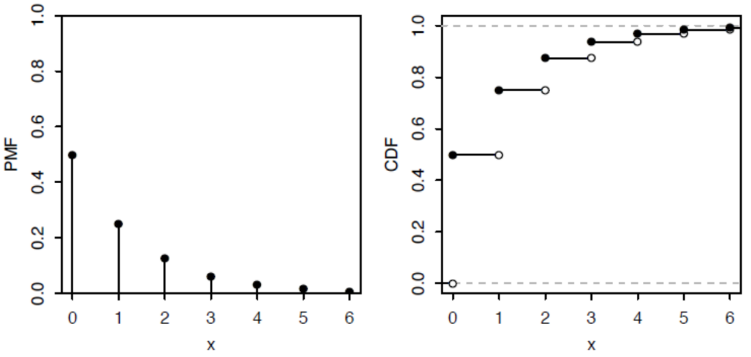
Geometric Random Variable
E(X)=? Var(X)=?

Slide 84
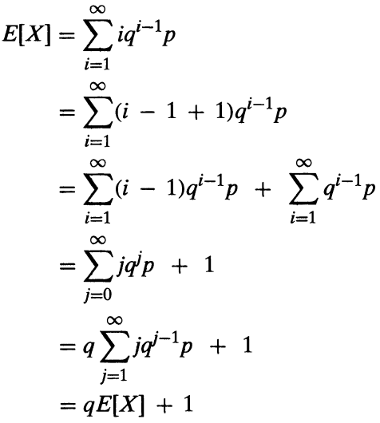

Geometric Random Variable

Slide 85
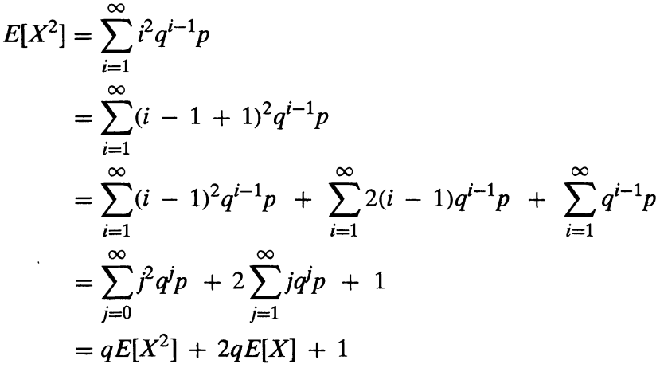


Geometric Random Variable

Slide 86
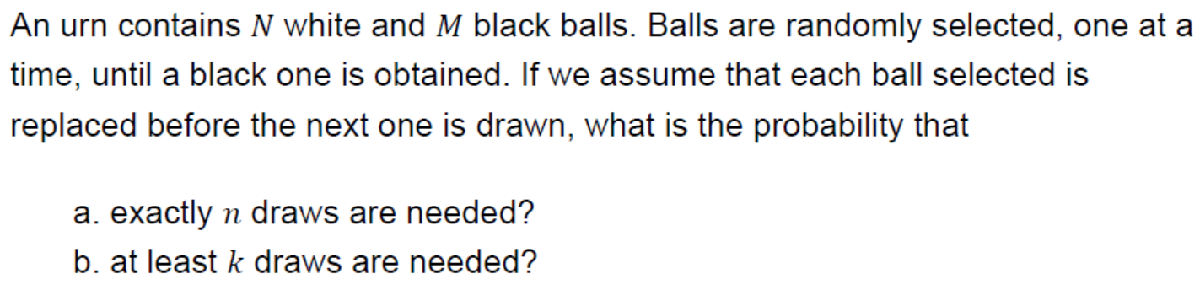
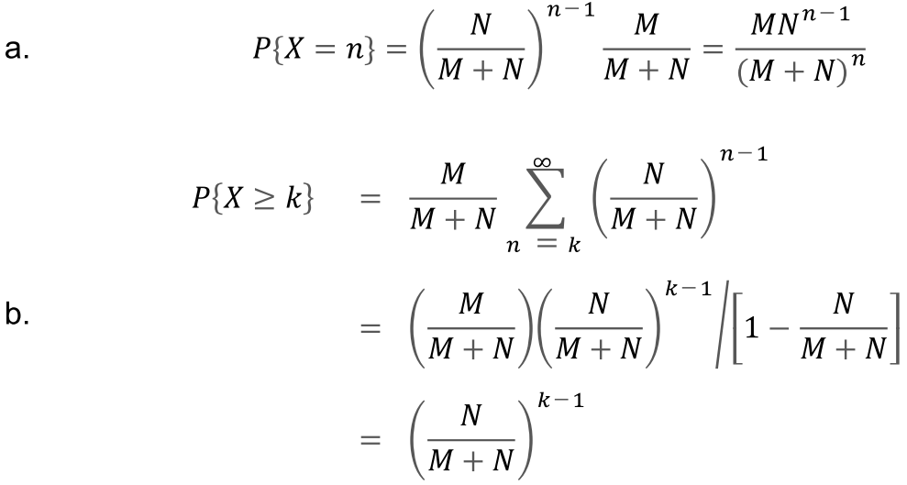
Example 3.14

Slide 87
Negative Binomial Random Variable
Suppose a Bernoulli trial (S,F) is repeated until r successes occur totally. Let X = the trial on which the r^{th} success (S) occurs. Find the probability distribution of X.
Note: the possible values of X are
{r, r + 1, r + 2, r + 3, r + 4, r + 5, … }
The sample space for the experiment (repeating a Bernoulli trial until r successes occurs) consists of sequences of S’s and F’s having the following properties:
Each sequence will contain r S’s
The last outcome in the sequence will be an S.

Slide 88
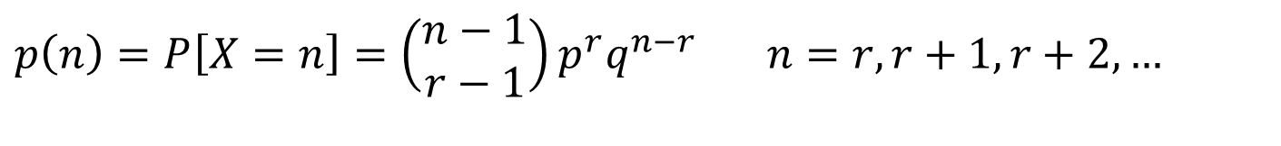
Negative Binomial Random Variable
A sequence of length n containing exactly r S’s
SFSFSFFFFS FFFSF … FFFFFFS
The last outcome is an S
The # of S’s in the first n – 1 trials is r – 1.
$$p\left(n\right)=P\left[X=n\right]=\left(\begin{matrix}n−1 \\ r−1\end{matrix}\right)p^{r}q^{n−r} n=r,r+1,r+2,…$$
The # of ways of choosing from the first n – 1 trials, the positions for the first r – 1 S’s.
The probability of a sequence containing r S’s and n – r F’s.

Slide 89
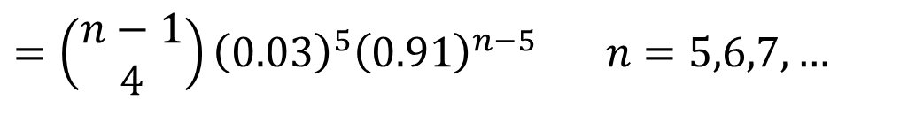
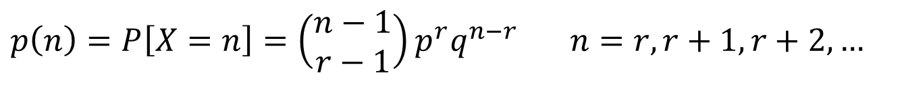
Example 3.15
Suppose the chance of winning any prize in a lottery is 3%. Suppose that I play the lottery until I have won r = 5 times. Let X denote the number of times that I play the lottery. Find the probability function, p(n), of X
$$p\left(n\right)=P\left[X=n\right]=\left(\begin{matrix}n−1 \\ r−1\end{matrix}\right)p^{r}q^{n−r} n=r,r+1,r+2,…$$
$$=\left(\begin{matrix}n−1 \\ 4\end{matrix}\right){\left(0.03\right)}^{5}{\left(0.91\right)}^{n−5} n=5,6,7,…$$

Slide 90



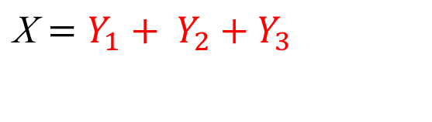
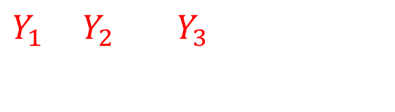
E(X) and Var(X)
$Y_{1}$ ${ Y}_{2}$ ${ Y}_{3}$
FS FFS FFFFS
r =3
X is the total number of trails
${\text{X}=Y}_{1}$ ${+ Y}_{2}$ ${+ Y}_{3}$

Slide 91
Hypergeometric Random Variable
A urn containing N balls, (m white balls, N-m black balls) , Randomly draw n balls, Let X denote the number of white balls drew in the n balls.
When having replacements, what does X distributed as?
When without replacements, what does X distributed as?

Slide 92
Hypergeometric Random Variable
Suppose we have N objects （two category）. Let m = the number of elements in category A , and let N-m = the number of elements in the other category B.
Now suppose that n elements are selected from N objects at random. Let X denote the elements from category A. (n – X will be the number of elements from category B.)
Find the probability distribution of X.

Slide 93
Hypergeometric Random Variable
Category B (N-m elements)
Category A (m elements)
n - x
x
sample (n elements)

Slide 94
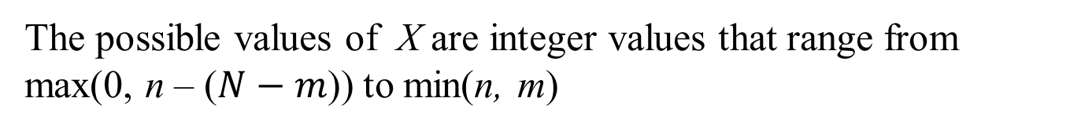
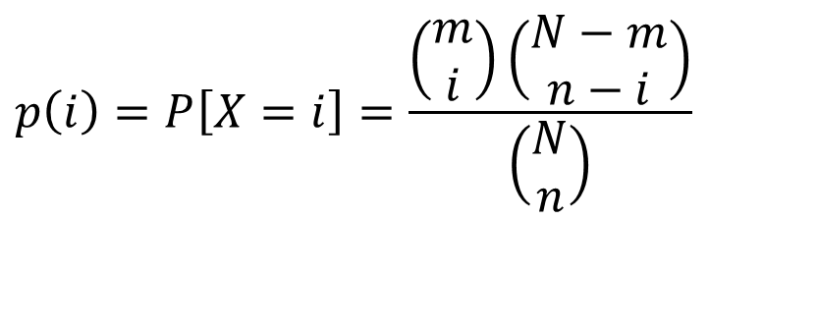
Hypergeometric Random Variable
Thus the probability function of X is:
The number of ways i elements can be chosen Group A .
The number of ways n - i elements can be chosen Group B .
$$p\left(i\right)=P\left[X=i\right]=\frac{\left(\begin{matrix}m \\ i\end{matrix}\right)\left(\begin{matrix}N−m \\ n−i\end{matrix}\right)}{\left(\begin{matrix}N \\ n\end{matrix}\right)}$$
The total number of ways n elements can be chosen from N elements
A random variable X that has this distribution is said to have the Hypergeometric distribution.
The possible values of X are integer values that range from max(0, n – ($N−m$)) to min(n, m)

Slide 95
Example 3.16
Example (Elk capture-recapture). A forest has N elk. Today, m of the elk are captured, tagged, and released into the wild. At a later date, n elk are recaptured at random. Assume that the recaptured elk are equally likely to be any set of n of the elk, e.g., an elk that has been captured does not learn how to avoid being captured again.

Slide 96
Sampling with and without replacement
Suppose we have N objects (a objects from category A and b objects from category B, N = a + b).
Now suppose that n elements are selected. Let X denote the elements from category A. (n – X will be the number of elements from category B.)
Find the probability distribution of X.
If the sampling was done with replacement.
If the sampling was done without replacement

Slide 97
Solution:
If the sampling was done with replacement.
Then the distribution of X is the Binomial distn.

Slide 98
If the sampling was done without replacement.
Then the distribution of X is the hyper-geometric distn.

Slide 99
Note:

Slide 100
for large values of N, a and b
Sampling with and without replacement
Thus
Thus for large values of N, a and b sampling with replacement is equivalent to sampling without replacement.

Slide 101
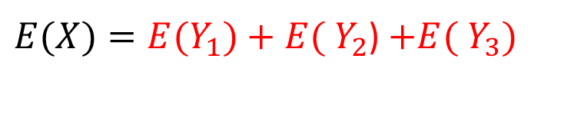
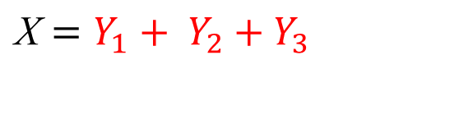
4.9 Expected value of sum of random variables
${\text{X}=Y}_{1}$ ${+ Y}_{2}$ ${+ Y}_{3}$
${E(X)=E(Y}_{1})$ ${+ E( Y}_{2}$) ${+E( Y}_{3})$

Slide 102
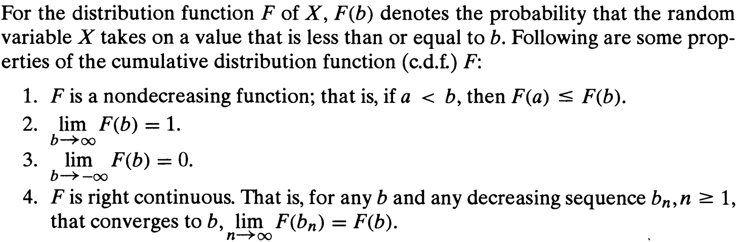
4.10 Properties of CDF

